Slide 1

Sisters Who
Code
We aspire to stand by the side of women around us

Slide 2
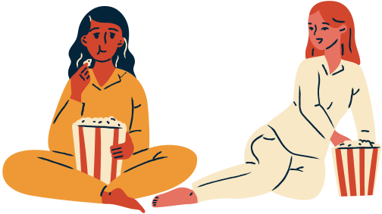
Women, If The Soul Of The Nation Is To Be Saved , I Believe You Must Become It's Soul
- Coretta Scott King

Slide 3

Agenda Of Our Application
Upliftment of Women around us by exposing them to various opportunities.
Enable Economic Freedom for Women by paving way for them to get working opportunities.
Create Solutions For Women's Safety by inspiring them from other women's journeys.
Make women believe that they can make a difference.

Slide 4



Sections Of Our Application
2
3
1
Scholarships &
Opportunities For
Women & Non Binary
Job Updates &
Details For Women In Tech & Non Tech
Experiences & Understandings Of Other Women

Slide 5


Why Us?
Through this application, we have tried to unite, inspire and lighten up the spark in every woman.
The opportunities & scholarships section will showcase the diversity hirings and enable women to start their journey and believe in themselves.
The Job Updates & Details section will keep them updated about recent job/internship openings pushing them to attain financial stability.
The Experiences & Understandings section will give exposure to real-world problems other women are facing and how they dealt with the same. This will act as a source of motivation for them.

Slide 6
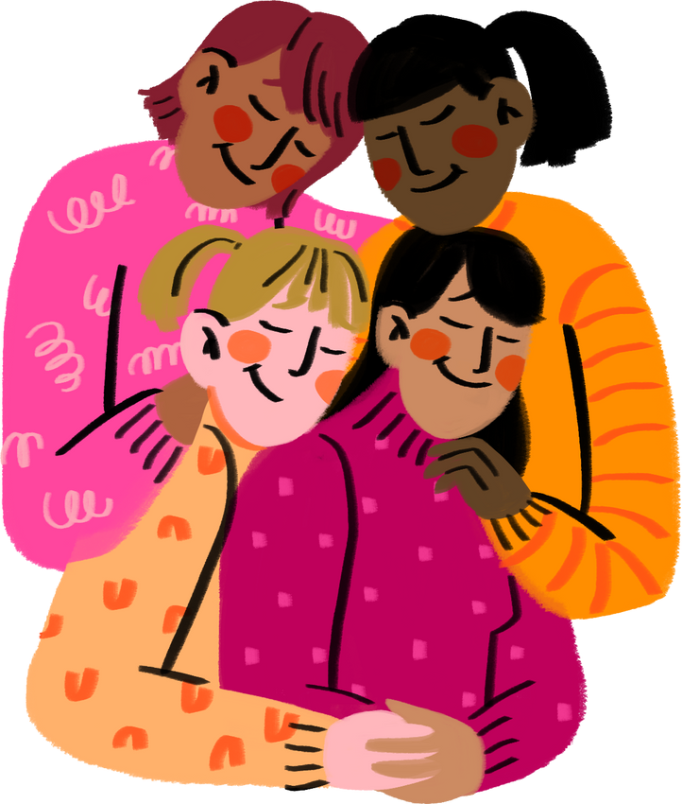

Tech Stacks Used
Web Part
HTML5
CSS3
JavaScript
Bootstrap
Deployment Part
Git & GitHub
VS Code
Microsoft Azure

Slide 7

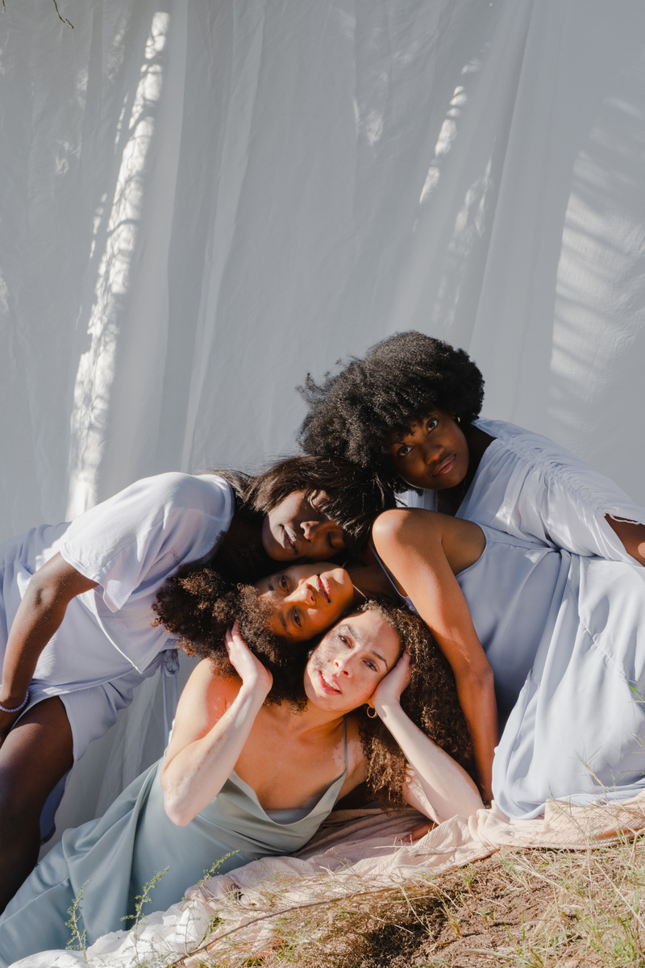

Future Aspects
ADDITION OF MORE DETAILS
DIRECT APPLICATION LINK
MENSTRUATION SCETION
More such opportunities & scholarships along with articles to the same will be updated
Direct application link to job portals in job updates can be added for making the app more user-friendly
A separate section for Menstruation can be added to make women aware about Menstrual Hygiene & Products

Slide 8
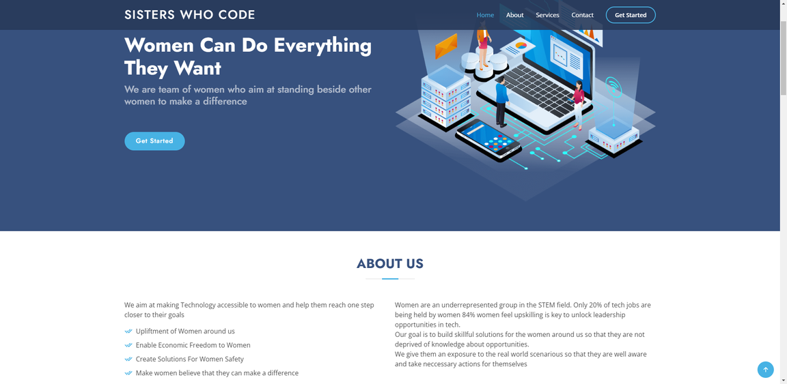
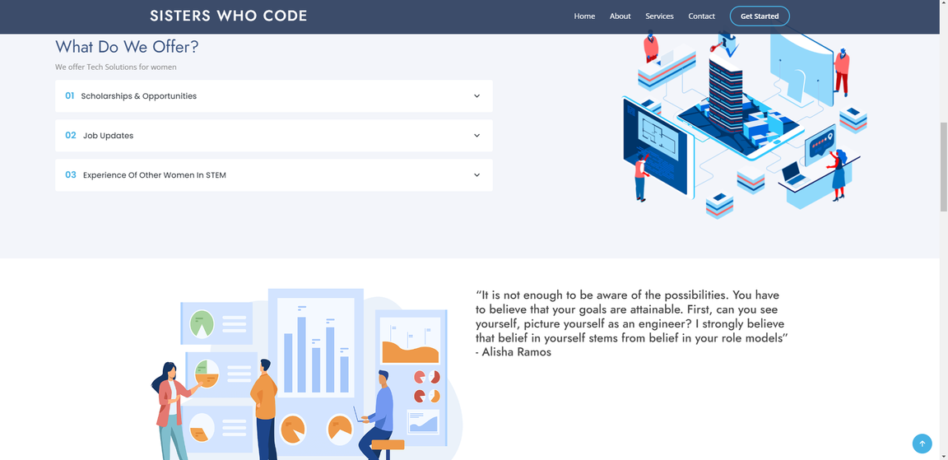
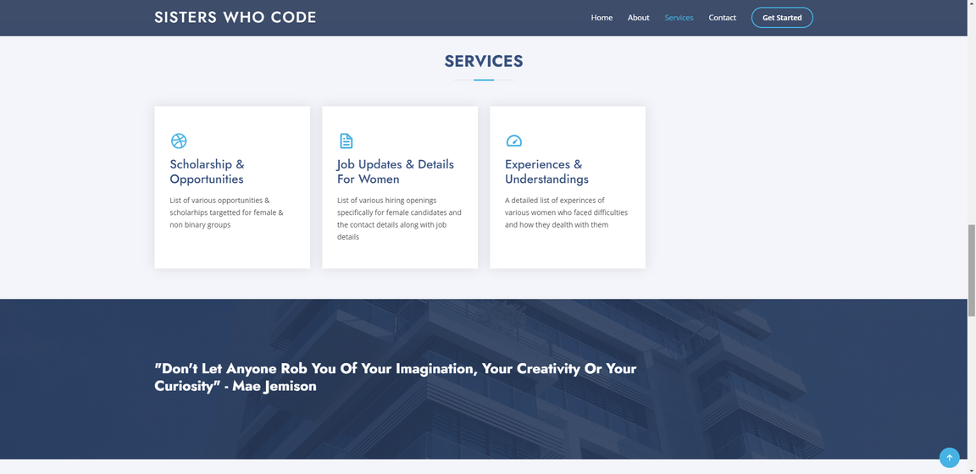
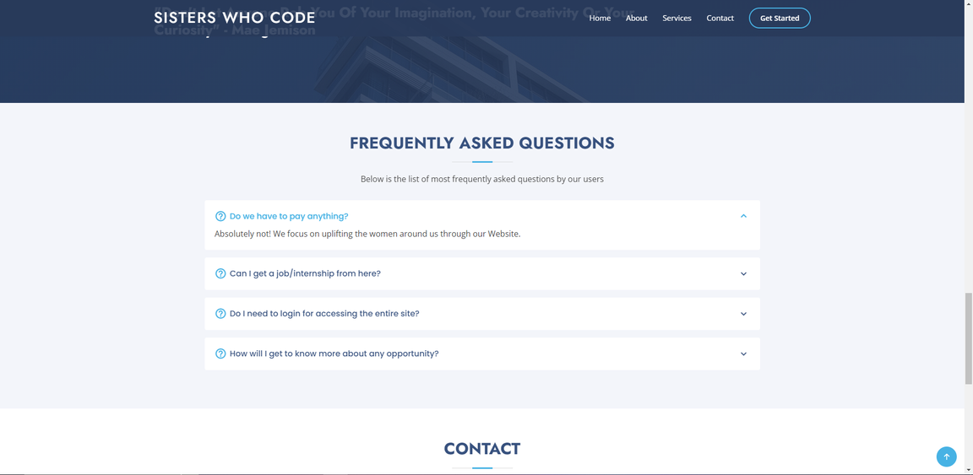
UI Of The Application

Slide 9
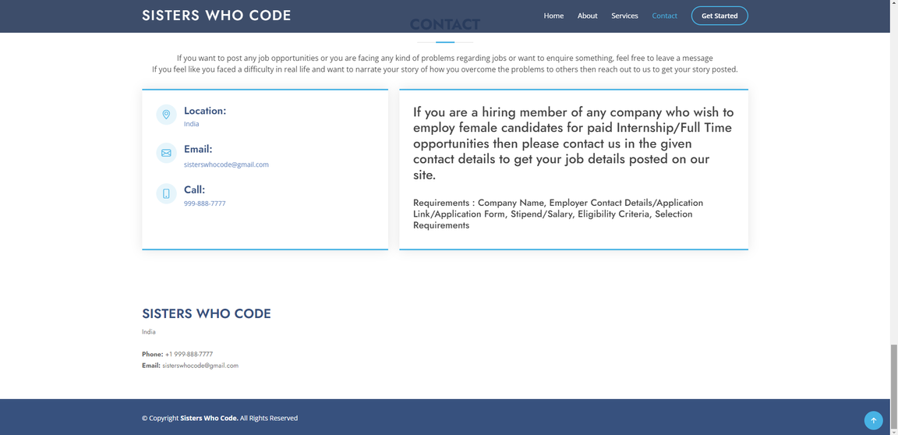
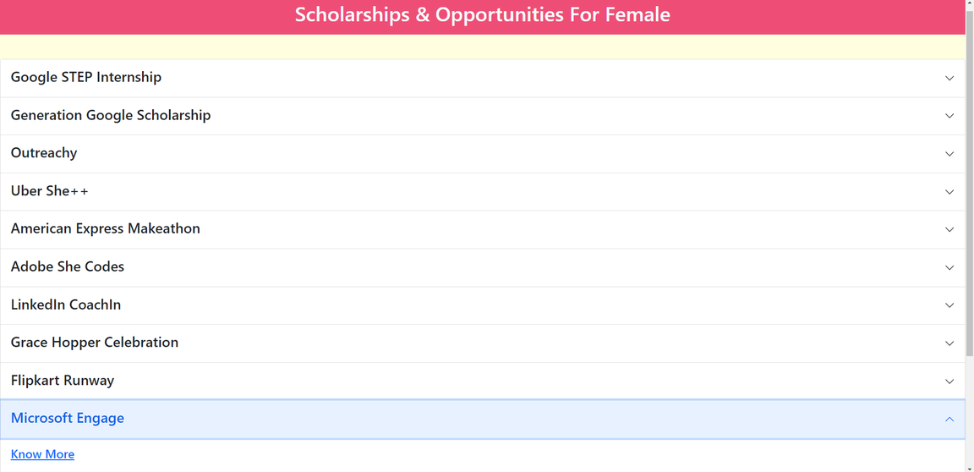
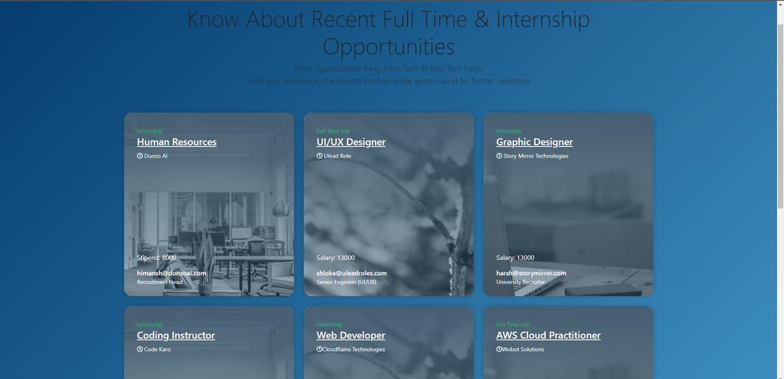
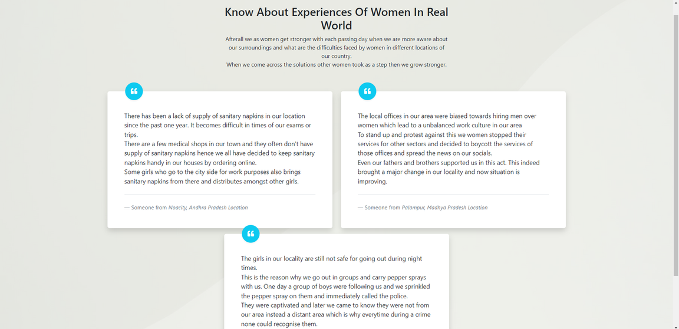
UI Of The Application

Slide 10
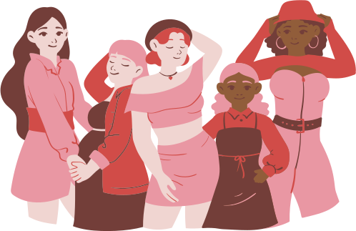
Thank you!
Learn to ask for things. You will constantly be figuring out how to acquire customers, investors, mentors, advisors, staff, and so on. Be concise, relevant, and brave.
- Angie Chang

